Slide 1
Three important questions
Three important questions to ask:
1. Whether column % change?
2. Is the relationship significant? (.05 as chi square significance for bivariate relationship)
3. How strong is the relationship?
Or what is the value of Cramer’s V?

Slide 2
Whether column % change?
      Table 1
      Class
      Lower Middle Upper
Drink yes 50% 50% 50%
no 50% 50% 50%
Conclusion: No change (the same)

Slide 3
Table 2
Class
    Lower Middle Upper
Drink yes 60% 65% 50%
no 40% 45% 50%
Conclusion: Not same – there is a change

Slide 4
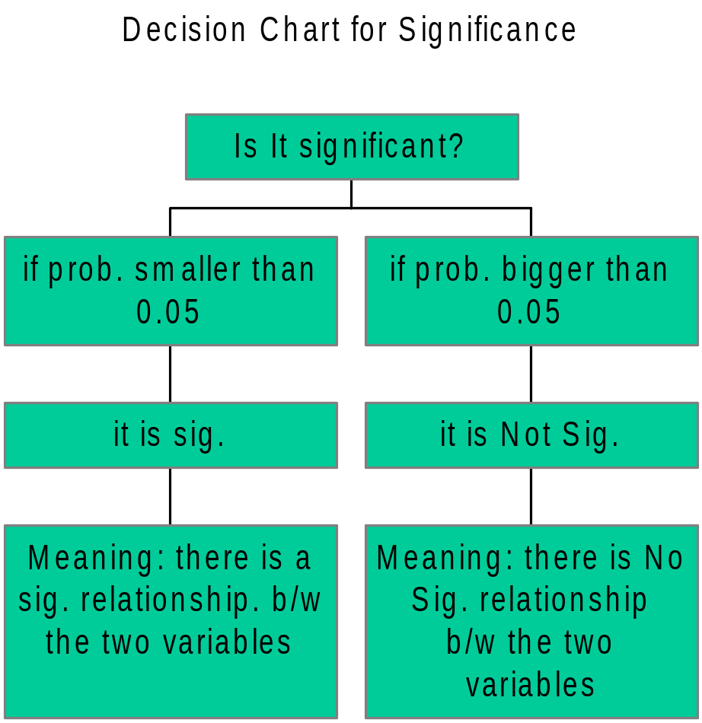
Significant?

Slide 5
Where to Look in SPSS Result?
Sample 1
Chi Square Tests
Value Df Asymp. Sig
(2tailed)
Person Chi-Square .51 1 .45
Is .45 bigger or smaller than .05? Sig or not?

Slide 6
Sample 2
Chi Square Tests
Value Df Asymp. Sig
(2tailed)
Person Chi-Square .20 1 .02
Is .02 bigger or smaller than .05? Sig or not?

Slide 7
Measures of association
The last question tries to examine how strong a relationship is b/w the two variables in crosstabulation.
How can you tell whether it is strong?
Use a measure called “CRAMER”S V (when both row and column variables are nominal or one of them is nominal).

Slide 8
Range of measures of association
(Cramer’s V)
Range varies from 0.00 to 1.00
the closer to 1.00, the stronger the relationship.
The closer to 0.00, the weaker the relationship.

Slide 9
Rule of Thumb
When measures of association such as Cramer’s V is:
1. Below .10 --- indicate a Weak relationship b/w the variables
2. Value b/w 0. 10 to 0.30 -- moderate relationship
3. Value 0.30 above - -- indicate strong relationship b/w the variables.

Slide 10
Where to find it in the output?
Look for “ Symmetric Measures”
Example: Symmetric Measures
Value Apporx. Sig
Nominal
cramer’s V .23 .001
Conclusion: moderate relationship b/w the variables

Slide 11
Example 2
Symmetric Measures
Value Apporx. Sig
Nominal
cramer’s V .09 .21
Conclusion: weak relationship b/w the variables

Slide 12
Significant?

